Slide 1
c
https://www.vanheusenindia.com/category/men/trousers-chinos-7
01
02
03
04
SAVJ HOSPITAL
MANAGEMENT
SYSTEM
05
MS 815 – Final Assignment
06
07
Submitted By:
Arabinda Das Siddhant Mohapatra
Jogil Jose Vivek Raveendran Pillai
08
c

Slide 2
https://www.vanheusenindia.com/category/men/trousers-chinos-7
c
Issues with conventional system
– difficult to retrieve and find specific information
– no provision to generate a consolidated department-wise details
The Project aims to implement a Hospital Management Application managed by the Admin
Two Interfaces – Patient Interface & Hospital Interface
Patient Interface
Admin can create an appointment for Patient if not registered before
Book an appointment for the existing patients
Search the list of patients registered under a particular dept.
Problem Statement
01
01
02
Proposed System
03
04
Design Description
05
06
07
08
c

Slide 3
https://www.vanheusenindia.com/category/men/trousers-chinos-7
c
Hospital Interface
Can view the complete Patient details along with searching for patients in a particular department
Generate a complete Hospital Report which includes Patient count & revenue for each department
The project can be improved further on:-
New department addition
Provision for Future Appointments
Clinical procedure tracking & Action based costing
01
01
02
03
Future Enhancements
04
05
06
07
08
c

Slide 4
htts://www.vanheusenindia.com/category/men/trousers-chinos-7
c
PROJECT IN AGILE…
PRODUCT BACKLOG
01
02
02
03
3. As an Admin, I need to View the Patients’ details and generate a complete Hospital Report
1. As an Admin, I need to manage new Patient’s registration and appointments
04
05
06
07
2. As an Admin, I need to manage existing Patient’s appointments
08
c

Slide 5
https://www.vanheusenindia.com/category/men/trousers-chinos-7
c
SPRINT 1 - KAN-BAN BOARD
SPRINT BACKLOG
DEVELOPMENT
TESTING
DONE
01
ONGOING
DONE
ONGOING
DONE
02
02
Documentation
Documentation
Documentation
03
Documentation
JJ
JJ
JJ
JJ
04
Login Interface
Login Interface
Login Interface
Login Interface
VR
VR
VR
VR
05
New Patient details
New Patient details
New Patient details
New Patient details
SM
SM
JJ
SM
JJ
SM
06
JJ
JJ
Existing Patient
Existing Patient
07
Existing Patient
Existing Patient
SM
AD
SM
AD
SM
AD
SM
AD
08
Test Cases
Test Cases
Test Cases
Test Cases
AD
AD
AD
AD
c

Slide 6
c
https://www.vanheusenindia.com/category/men/trousers-chinos-7
SPRINT 2 - KAN-BAN BOARD
SPRINT BACKLOG
DEVELOPMENT
TESTING
DONE
01
ONGOING
DONE
ONGOING
DONE
02
02
View Patient Details
View Patient Details
View Patient Details
View Patient Details
03
JJ
JJ
JJ
JJ
04
Search Patient
Search Patient
Search Patient
Search Patient
SM
SM
SM
SM
05
Hospital Report
Hospital Report
Hospital Report
Hospital Report
06
SM
AD
SM
AD
SM
AD
AD
SM
07
Documentation & Presentation
Documentation & Presentation
Documentation & Presentation
Documentation & Presentation
JJ
VR
JJ
VR
JJ
VR
JJ
VR
08
Test Cases
Test Cases
Test Cases
Test Cases
AD
AD
AD
AD
c

Slide 7
https://www.vanheusenindia.com/category/men/trousers-chinos-7
c
Model & Class Hierarchy
LOGIN
01
- user Name
- correctPass
SAVJHospitalController
02
- getUserName()
- getPassword()
- validateCredentials()
- loginScreen()
- fileName
- patientList<>
- patReceptionInt
- patInt
- hospitalInt
- department[ ]
03
03
04
Patient
NewPatient
05
- pID
- pDepartment
- pName
- pDate
- pCost
+ patientInterface()
+ patReceptionInterface()
+ hospitalInterface()
+ searchPatient()
+ createPatient()
+ pCost()
+ viewReport()
+ updateExistingPatient()
+ getPatCases()
+ getDepartmentCount()
+ getDepartmentRevenue()
+ viewPatients()
+ fileIn()
+ fileOut()
- pCost
06
+ newPatient()
+ pCost()
+ getPCost()
+ getPDepartment()
+ getPCost()
+ setPDepartment()
+ getPId()
+ getPName()
+ setPDate()
+ setPCost()
+ getPDate()
+ getPCost()
07
08
c

Slide 8
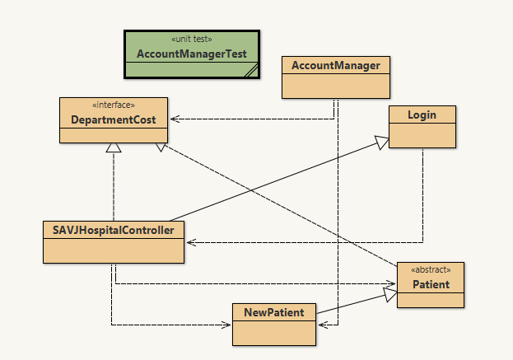
https://www.vanheusenindia.com/category/men/trousers-chinos-7
c
Project Diagram in BlueJ
01
02
03
03
04
05
06
07
08
c

Slide 9

https://www.vanheusenindia.com/category/men/trousers-chinos-7
c
OOPS Concepts in the Project
01
Abstraction
02
Patient Class -> All the functionality of the application is provided to the Admin
DepartmentCost Class -> As an interface for returning Revenue for each dept.
03
04
04
05
06
07
08
c

Slide 10
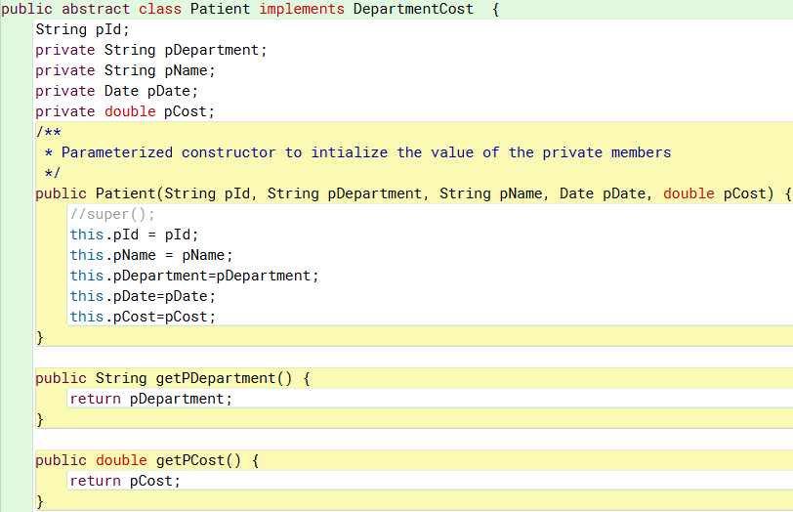
https://www.vanheusenindia.com/category/men/trousers-chinos-7
c
Encapsulation
01
Private Variables declared in the ‘Patient Class’ are accessed via Public Methods
02
03
Private Variables
04
05
05
06
07
Getters and Setters
08
c

Slide 11
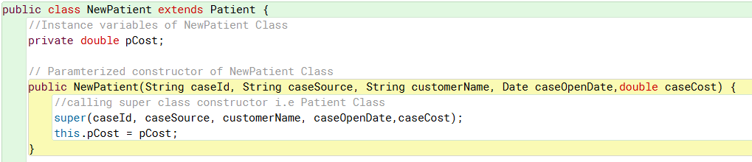
https://www.vanheusenindia.com/category/men/trousers-chinos-7
c
Inheritance
‘NewPatient’ Class inherits the properties of Patient Class -
01
02
03
04
05
06
06
07
08
c

Slide 12
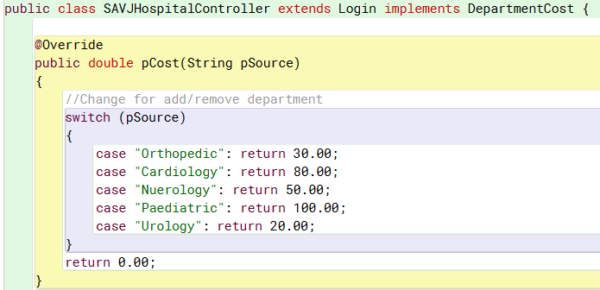

https://www.vanheusenindia.com/category/men/trousers-chinos-7
c
Polymorphism
01
The function ‘pCost()’ has different functions in the Controller Class and DepartmentCost Class
02
03
04
05
06
pCost () function to return the Revenue from each department
07
07
08
pCost () function to return the Booking cost for each department
c

Slide 13
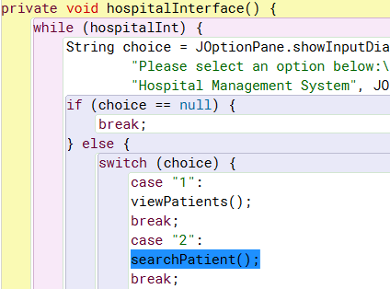
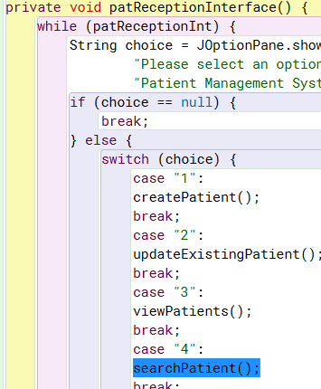
https://www.vanheusenindia.com/category/men/trousers-chinos-7
c
Coupling & Cohesion
01
Design emphasized on High Cohesion and Low Coupling –
Used same code for Searching the Patient details for both of the Interfaces
02
03
04
05
06
07
08
08
Calling searchPatient() in the hospitalInterface()
Calling searchPatient() in the patientInterface()
c

Slide 14
https://www.vanheusenindia.com/category/men/trousers-chinos-7
c
THANK
YOU !!!
MS 815 – Final Assignment
c

